Slide 1
Python vs js
https://www.freecodecamp.org/news/python-vs-javascript-what-are-the-key-differences-between-the-two-popular-programming-languages/

Slide 2
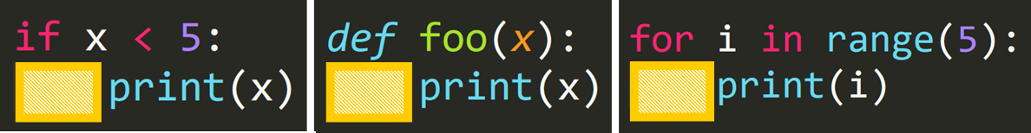
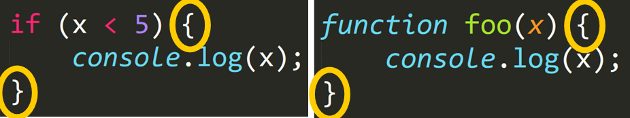
Code blocks

Slide 3
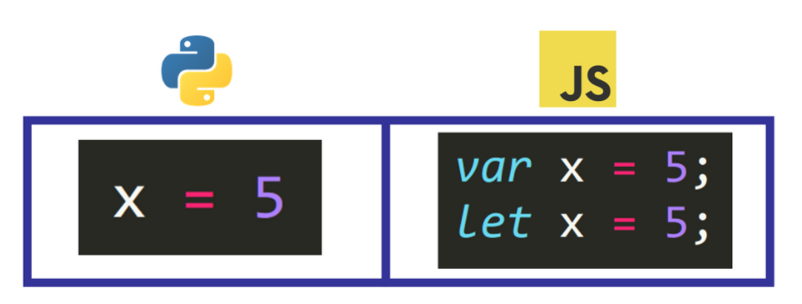
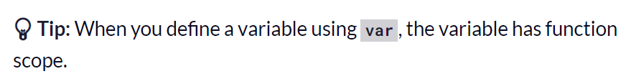
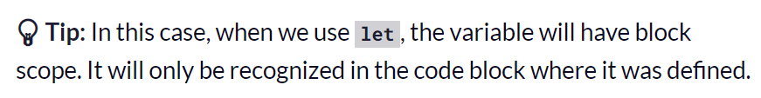
variables

Slide 4
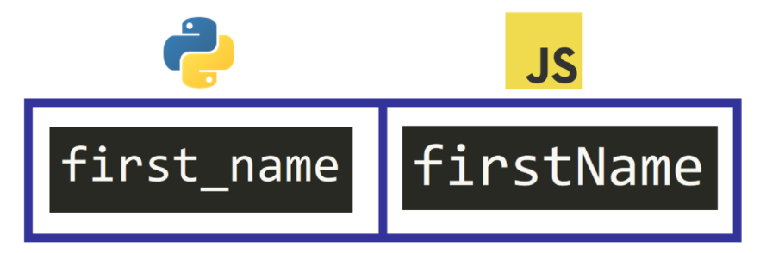
Naming variables

Slide 5
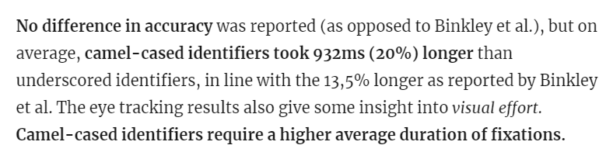
code comprehension
software design principles as an act of communication
the cooperative principle in Linguistics
https://whatheco.de/2013/02/16/camelcase-vs-underscores-revisited/

Slide 6
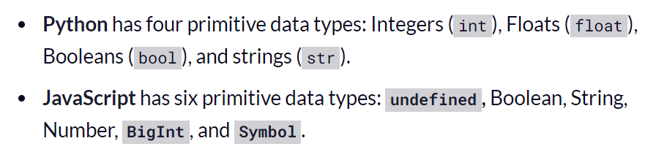
Data types

Slide 7
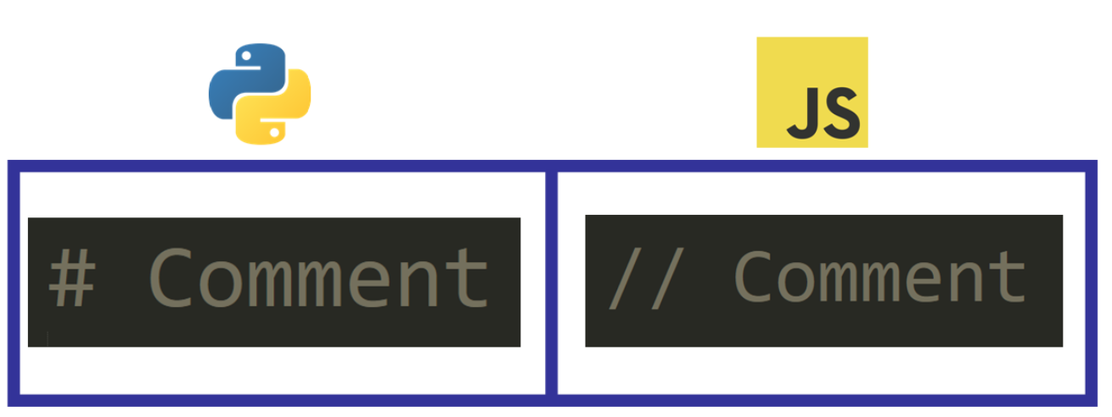
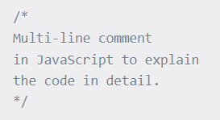
comments

Slide 8
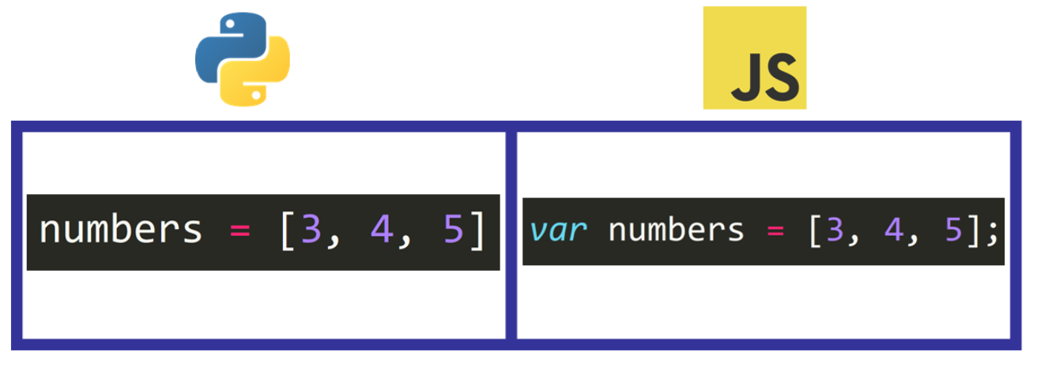
array

Slide 9
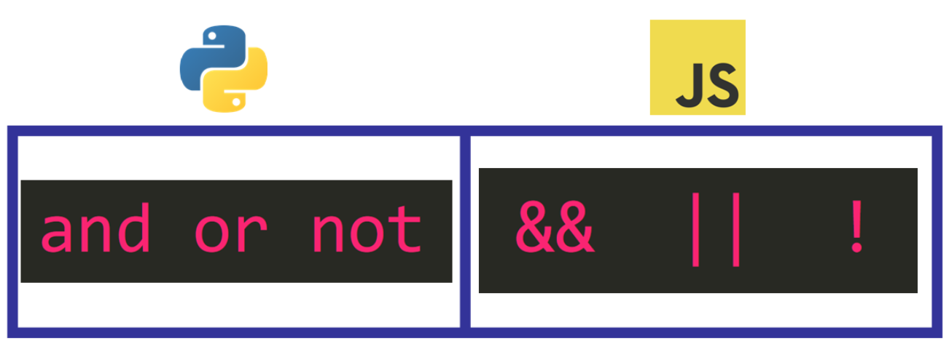
Logic operators

Slide 10
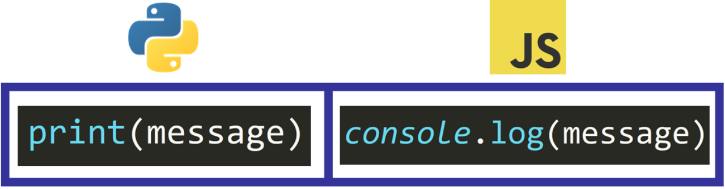
Output / debug

Slide 11
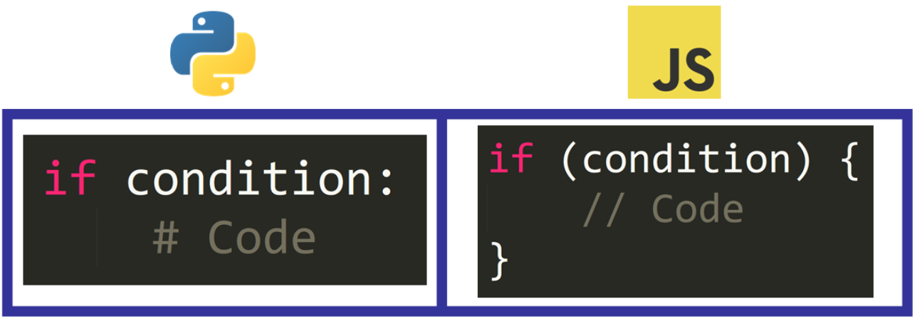
Conditionals / selection

Slide 12
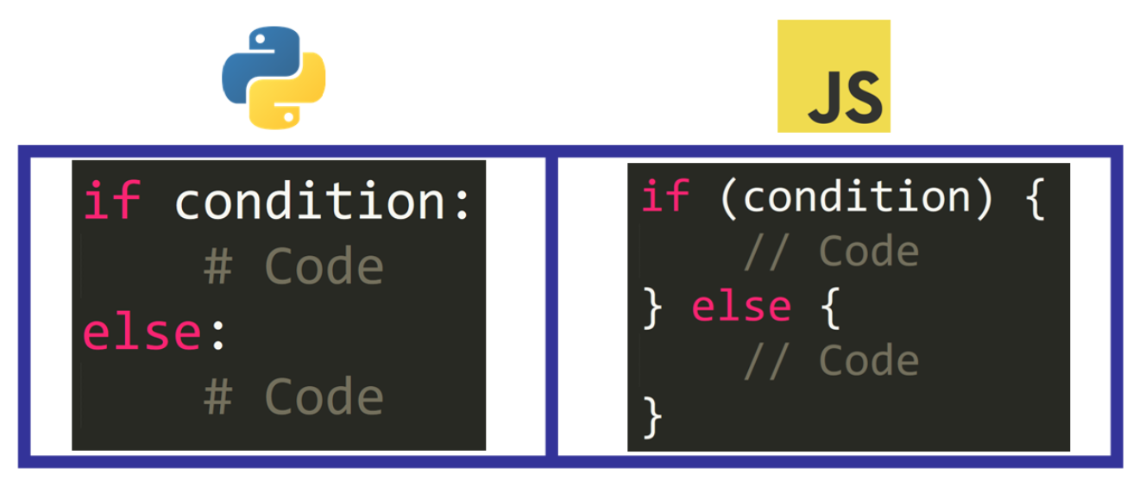
else

Slide 13
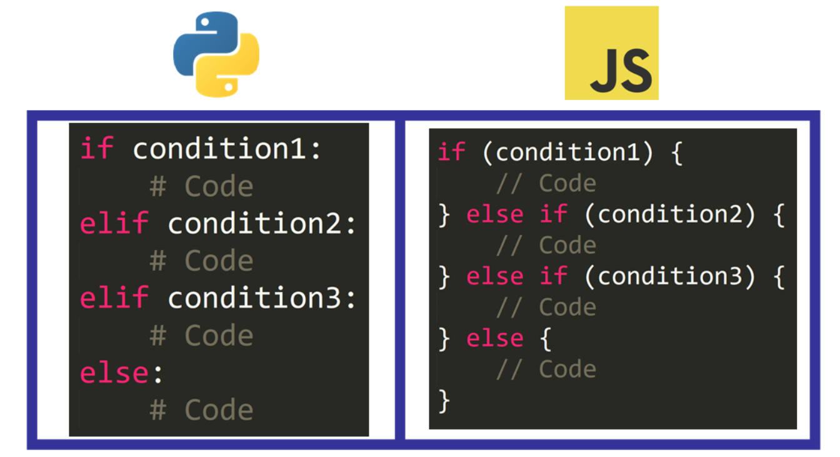

Slide 14
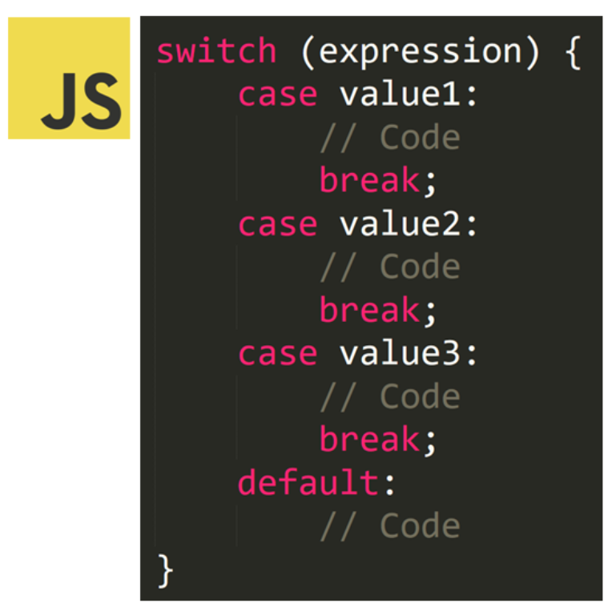

Slide 15
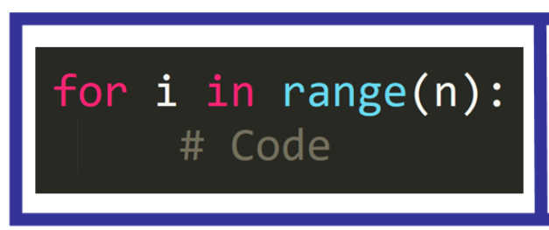
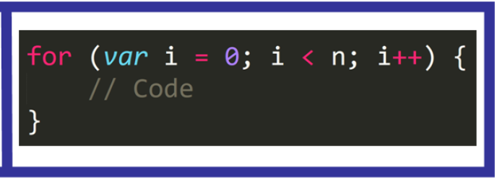

Slide 16
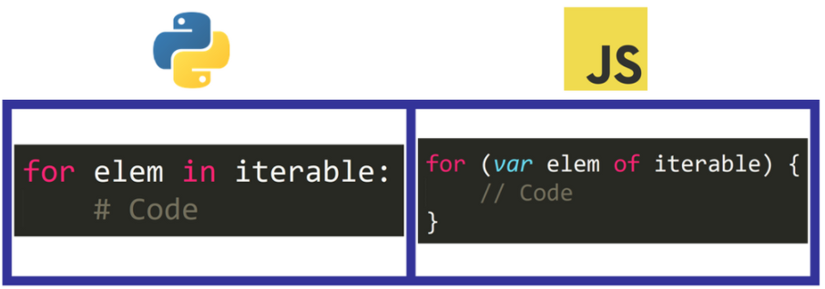
Loop over an iterable (e.g. list)

Slide 17
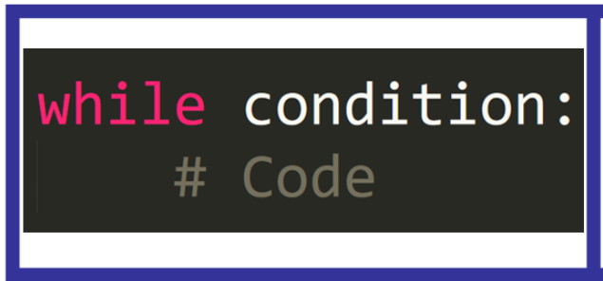
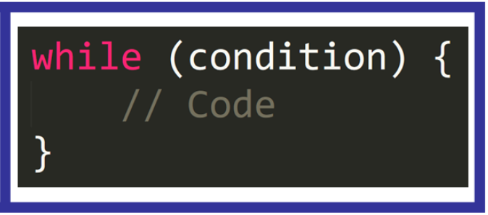

Slide 18
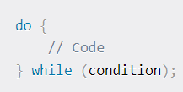
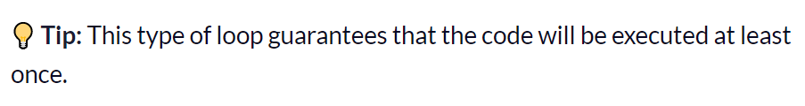
DO … WHILE

Slide 19
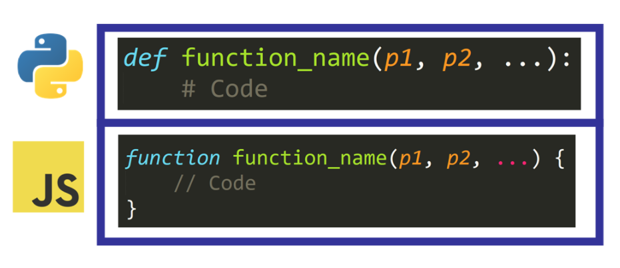
FUNCTIONS

Slide 20
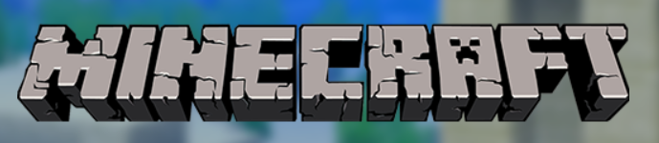

Examples look like this:
This doesn’t look like JS, I think it’s typescript
Typescript is a MS tool that is a superset of JS (extends it) and is strongly typed.

Slide 21
TypeScript
What is TypeScript?
TypeScript is an open-source language that was developed by Microsoft. It is a superset of JavaScript, which means that you can continue to use the JavaScript skills you've already developed and add certain features that were previously unavailable to you.
Type hints
The core feature of TypeScript is its type system. In TypeScript, you can identify the data type of a variable or parameter by using a type hint. With type hints, you describe the shape of an object, which provides better documentation and allows TypeScript to validate that your code is working correctly.
TypeScript is a strict superset of ECMAScript 2015 (ECMAScript 6 or ES6). This means that all JavaScript code is also TypeScript code, and a TypeScript program can seamlessly consume JavaScript.
https://docs.microsoft.com/en-us/learn/modules/typescript-get-started/2-typescript-overview

Slide 22
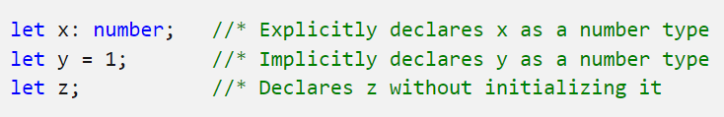

Examples

Slide 23
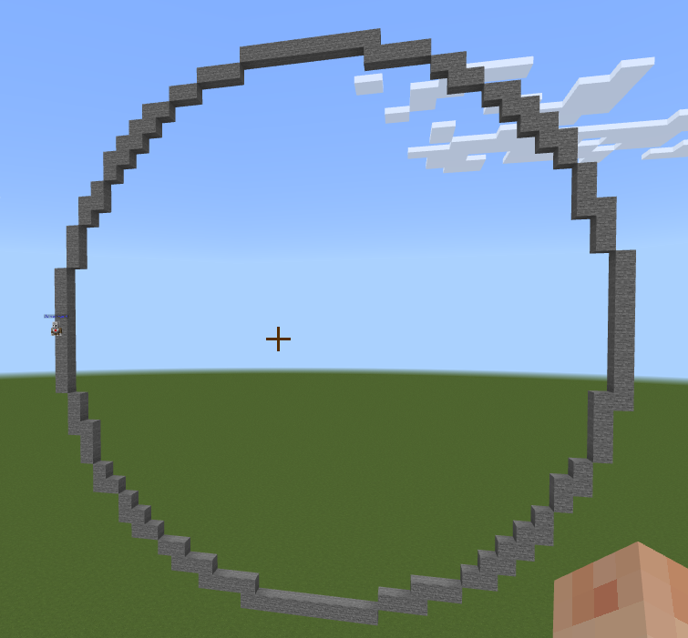
Can you draw a circle?

